Slide 1
DLZHP LLC Property Management Database🏡
Zoe Pesce
MISM 3403
Database Lab Work

Slide 2
Database Requirements:
For each building owned: a building ID (unique), building address, building number of floors, price building was purchased at, year building was purchased, year building was built, building age (derived from year built and current date)
For each Apartment: a AptNo (partially unique, i.e., unique within a building), apartment number of bedrooms, apartment total rooms, rent amount
For each Tenant: a Tenant ID (unique), Tenant Full Name (composed of Tenant First Name and Tenant Last Name), multiple Tenant phone numbers, Tenant birthday, Tenant age (derived from tenant birthday and current date)
For each Building Manager: a Manager ID (unique), Manager Full Name (composed of Manager First Name and Manager Last Name), Manager Birthday, Manager Age (derived from manager birthday and current date), Manager salary, Manager bonus (optional), multiple manager phone numbers
For each building inspector: an Inspector ID (unique), Inspector full name (composed of inspector first name and inspector last name)
For each phone type: a phone type ID (unique) and phone type
Each building has one or more apartments. Each apartment is located in exactly one building.
Each apartment is leased to one or many tenants or it can be leased to none. Each tenant leases one or many apartments.
Each building is managed by exactly one manager. Each manager manages one or many buildings.
Each manager resides in exactly one building. Each building has one manager residing in it or no managers residing in it.
Each inspector inspects one or many buildings. Each building is inspected by one or many inspectors.
For each building that a particular inspector inspects, the dates of the last inspection and the date of the next future inspection by the inspector are recorded.
For each apartment a tenant leases, the Tenant's move in date and the Tenant's lease term date are recorded.

Slide 3
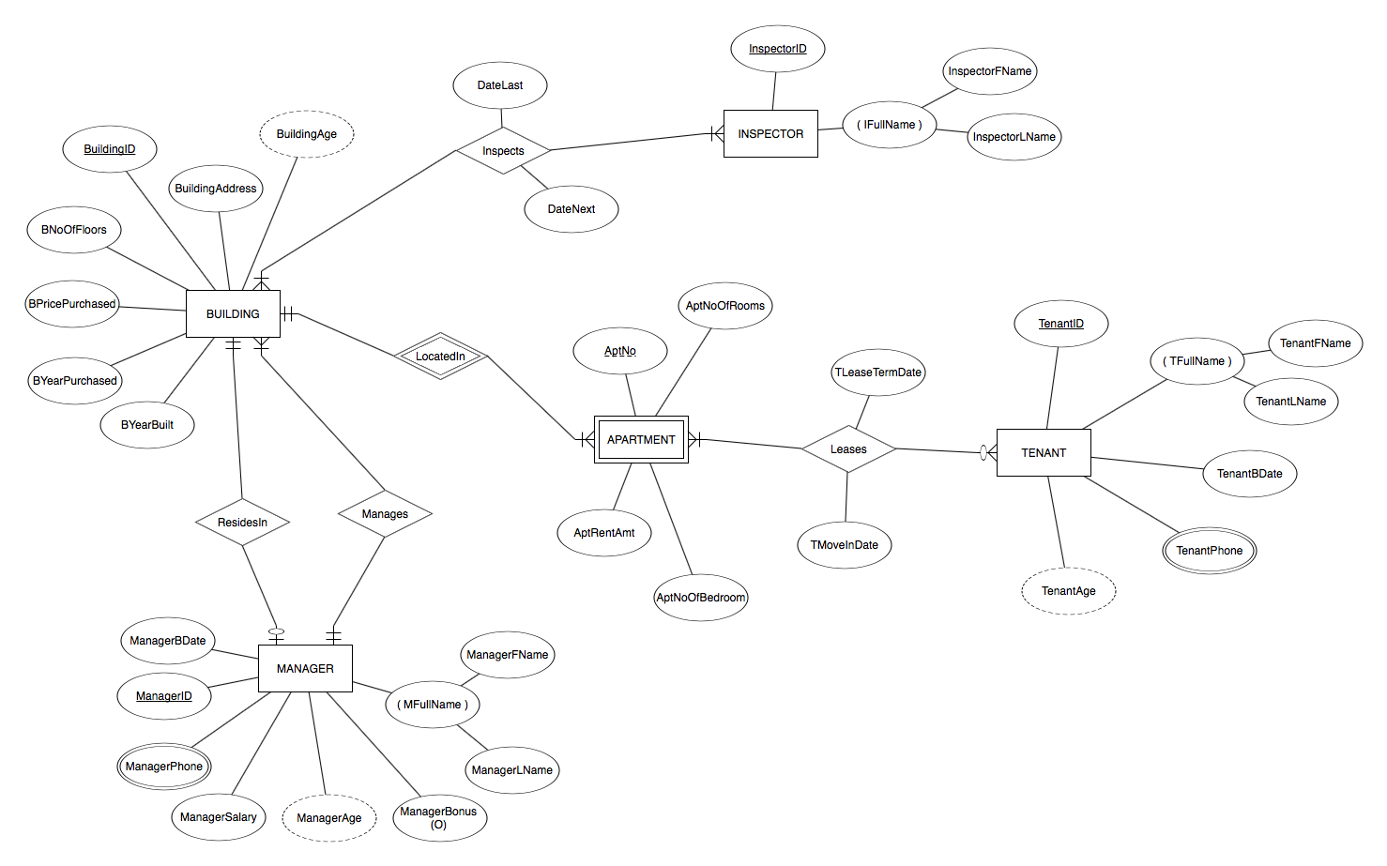
ER Diagram:

Slide 4
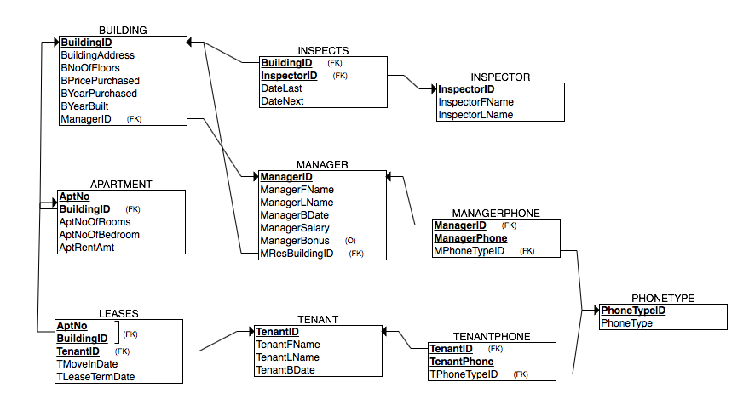
Relational Schema:

Slide 5
Delete, Insert, and Update Commands:
#Tenant T28, Chris, got a new job in Massachusetts and is moving out
DELETE FROM tenantphone WHERE TenantID = 'T28';
DELETE FROM leases WHERE TenantID = 'T28';
DELETE FROM tenant WHERE TenantID = 'T28';
#A new Tenant moves in to B6 Apt #4
INSERT INTO tenant VALUES ( 'T28','Sally','Stone','1980-11-13');
INSERT INTO tenantphone VALUES ( 'T28','653-555-0126','M');
INSERT INTO tenantphone VALUES ( 'T28','212-555-1818','H');
INSERT INTO leases VALUES ( 'B6',4,'T28','2018-05-01','2019-05-01');
#Hannah, T2, gets a family and friends discount on her rent and it is lowered to $2,000.00 a month
UPDATE apartment SET AptRentAmt = 2000.00 WHERE BuildingID = 'B1' AND AptNo = 2;

Slide 6
Select and Group By Commands:
#DLZHP LLC is considering lowering rents by 5% and would like to see what each apartment would rent for when AptRentAmt is decreased by 5% compared to what they're currently renting for
SELECT BuildingID, AptNo, AptRentAmt, AptRentAmt*0.95 FROM apartment;
#DLZHP LLC would like to see how many numbers they have recorded for each type of phone: mobile and home
SELECT TPhoneType, COUNT(*) FROM tenantphone GROUP BY TPhoneType;

Slide 7
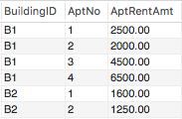
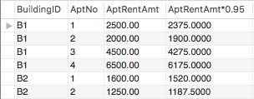
Select Command Results:
#DLZHP LLC is considering lowering rents by 5% and would like to see what each apartment would rent for when AptRentAmt is decreased by 5% compared to what they're currently renting for
SELECT BuildingID, AptNo, AptRentAmt, AptRentAmt*0.95 FROM apartment;

Slide 8
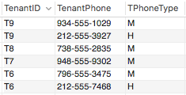

Group By Command Results:
#DLZHP LLC would like to see how many numbers they have recorded for each type of phone: mobile and home
SELECT TPhoneType, COUNT(*) FROM tenantphone GROUP BY TPhoneType;

Slide 9
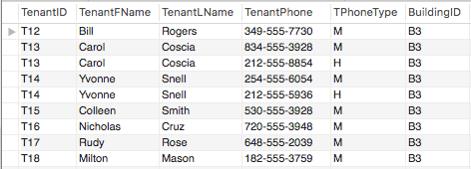
Join/Nested Command & Results:
#Tony wants to throw a tenant appreciation party for B3 and would like a list of tenants who live in B3 that includes their full name, phone numbers, and phone types
SELECT t.TenantID, t.TenantFName, t.TenantLName, tp.TenantPhone, tp.TPhoneType, l.BuildingID
FROM tenant t, tenantphone tp, leases l
WHERE t.TenantID = tp.tenantID AND t.tenantID = l.TenantID AND l.TenantID IN (SELECT TenantID FROM leases WHERE BuildingID = 'B3')
ORDER BY l.TenantID;

Slide 10
References
ERDPlus. (n.d.). Retrieved from https://erdplus.com/#/
Jukic, N., Vrbsky, S., & Nestorov, S. (2017). Database systems: Introduction to databases and data warehouses. Burlington, VA: Prospect Press.
Special thanks to all the people who made and released these awesome resources for free:
Presentation template by SlidesCarnival

